Slide 1
Session 3 - Combating Discrimination Online (Part 1)

Slide 2
Outline – Session 3
Causes of discrimination
  Psychological roots of discrimination
  Social manifestation of discriminatory psychology
  Cultures of hate and discrimination
  Tolerance versus acceptance
Understanding online dynamics
  Examples of anti-discrimination efforts worldwide
  Europe, Sub-Saharan Africa, United States
  Challenge: linking online efforts to real-world change

Slide 3
Causes of Discrimination

Slide 4
Psychological Roots of Discrimination
“Othering” is a very human phenomenon
Humans have a demonstrated tendency to divide into groups
Divisions are very can be very powerful
Much psychological research done on this tendency
Individuals tend to identify more with people similar to themselves

Slide 5
Psychological Roots of Discrimination
Everyone does it to some extent
  Think of traveling and meeting someone from your country
  More comfortable when people have common reference point
Not necessarily a bad thing in mild forms since holds groups together
Danger appears when taken to an extreme

Slide 6
Psychological Roots of Discrimination
Social animals favour members of their “team”
Observed in humans even when randomly divided into groups
Various experiments demonstrate this
  Robber’s Cave
  Stanford Prison Experiment
  People demonstrate preference even for “team” members they have never met

Slide 7
Psychological Roots of Discrimination
Randomly-assigned group identities can be strong
Group identities can be much stronger when associated with…
  Language
  Culture
  Race
  Identity

Slide 8
Psychological Roots of Discrimination
Dangerous subconscious logic
  I am good
  People similar to me are good
  My group is best
  People and groups unlike us are less good
  Extreme cases: People and groups unlike us are evil or dangerous

Slide 9
Social Manifestation of Discriminatory Psychology
Loss of opportunities for both individuals and groups affecting all aspects of life
  Employment
  Education
  Political participation
  Family and relationships

Slide 10
Social Manifestation of Discriminatory Psychology
The “triad” of human rights abuses
Roles can change and sometimes people are all three at different times
Anti-discrimination campaigns must focus on turning bystanders into interveners
Perpetrators
Victims
Bystanders

Slide 11
Cultures of Hate and Discrimination
Affect both individuals and all of society
Damaging to society on many levels
  Social
  Economic
  Political / democratic
Create invisible barriers that divide society prevent valuable interactions

Slide 12
Tolerance versus acceptance
Tolerance – Seeing others as different, not necessarily valuing them, but living with their presence if required (i.e. if legally enforced)
  Similar to negative peace – The mere absence of open conflict
Social media can be used to build social ties between individuals which break down barriers between groups
“Twitter diplomacy” at international level is similar

Slide 13
Tolerance versus acceptance
Acceptance – Viewing others as fully equal human beings with the same rights and opportunities - even if they are different – is ideal
    Similar to positive peace – The building of ties in cooperative peace
  At individual level, broadening circles of social obligation is key
  Will happen as a result of being exposed to different people
Nation
Language Group
Ethnic Group
Family
Self

Slide 14
Understanding Online Dynamics

Slide 15
Social Media - Anonymity, Speed, and Reach
Discrimination and violence result from hatred and fear
Hatred and fear start with words
Social media dramatically lowers barriers to spreading a message
Traditional media rely on…
  Infrastructure controlled by governments or corporations
  Professional editorial standards

Slide 16
Social Media - Anonymity, Speed, and Reach
Words can now spread…
  Faster than ever before
  Farther than ever before
Anyone can say them
Great potential social and democratic benefits
Also great danger if used irresponsibly or maliciously

Slide 17
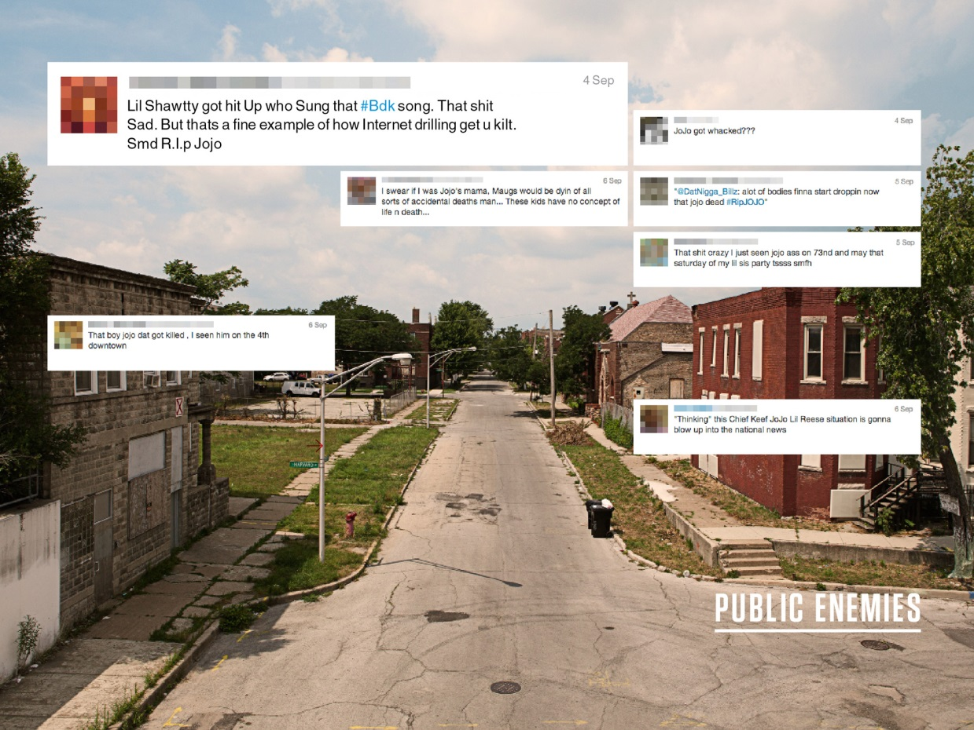
Gang Violence in the United States
Social media used my gang members to incite hatred and violence against rival groups
Often includes stereotyping or generalization of people from other neighbourhoods
In this culture of hate and discrimination, simple online insults can quickly turn into deadly violence

Slide 18
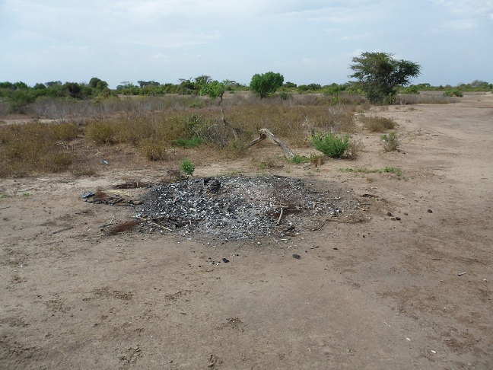
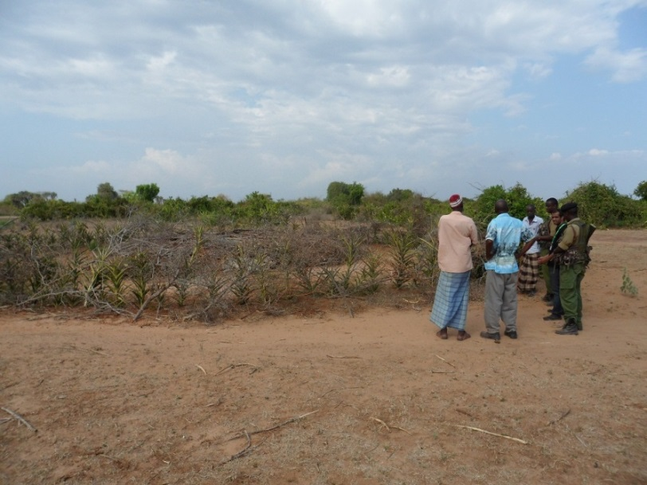
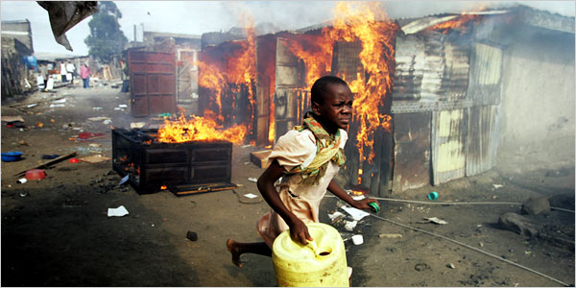
Inter-communal Violence in Kenya
Country has 42 different ethnic groups
A few groups dominate economy and politics
Others feel excluded at all levels
Political disputes become ethnic disputes
Social and mobile media used to incite hatred and organize violence

Slide 19
Examples of Anti-Discrimination Efforts Worldwide
Governmental examples
Non-governmental organization examples
Private sector examples
Lessons can be learned from…
  Peacebuilding
  Legal measures
  Online moderation

Slide 20

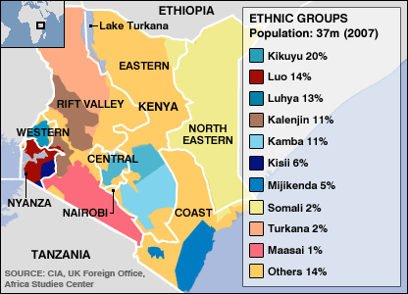
Kenya – Media Campaigns for Cultural Change
Long-term approach which began immediately after 2007-2008 violence
Incorporated all forms of media (broadcast, internet, and mobile)
Incorporated media figures and entertainers, ethnic and religious leaders
Sought to build understanding and links between groups
Urged peace and loyalty to Kenya rather than ethnic group

Slide 21

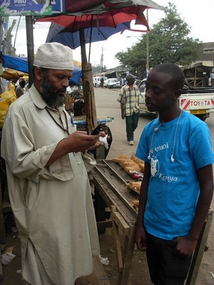
Kenya – Sisi Ni Amani - Community Intervention by SMS
Use mobile phone reports to identify areas at risk of violence
Broadcast messages calling for social unity
Also discourages ethnocentric thinking
Volunteers play an important part in community intervention

Slide 22
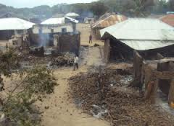
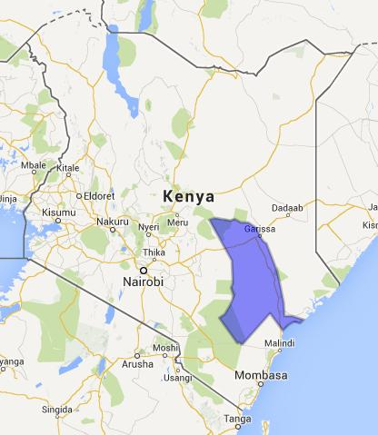
Kenya – Countering Misinformation via SMS
Rumours contribute to negative perceptions
Negative perceptions cause discrimination
Discrimination drives hate and violence
Project will use mobile phone reports to recognize new rumours
Counter messages will be used to reduce influence of rumours
Long-term goal is to build trust and reduce discrimination between groups

Slide 23
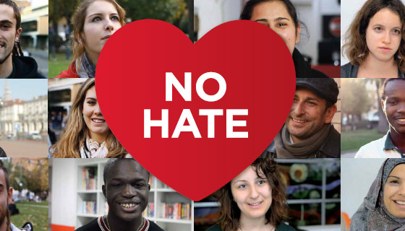
Council of Europe - “No Hate Speech” Movement
Aims to engage youths across Europe
Identifying online hate speech
Countering online hate speech
Translating online communications into “real world” actions
Turns youths from bystanders into interveners

Slide 24


France – Punishing Anti-Semitism on Twitter
Union of Jewish Students and other anti-racism groups sued Twitter to disclose data
Data would be used to identify users spreading anti-Semitic tweets
Users violated French hate speech laws
Result came after a legal dispute lasting several months
Seen by some as balancing free speech with anti-racism efforts

Slide 25

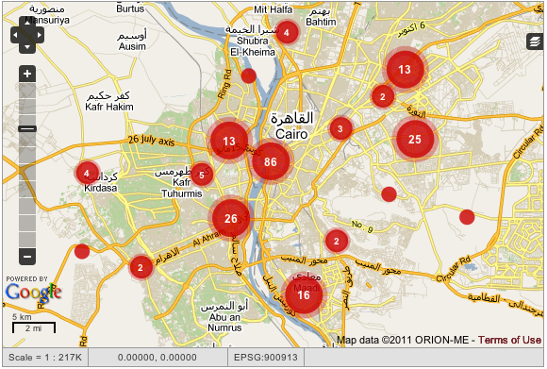
Egypt – HarassMap – Changing Attitudes
Social media and SMS reports used to map sexual harassment incidents
Map used to direct and support community intervention efforts
Egyptian society traditionally very accepting of sexual harassment against women
Ultimate goal is to change societal attitudes to make sexual harassment unacceptable

Slide 26

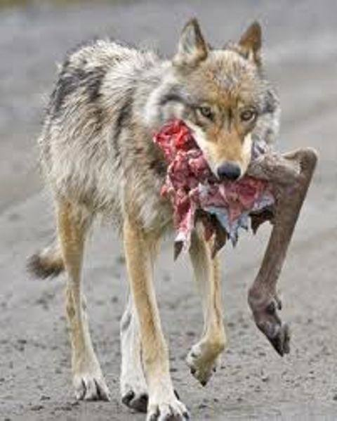
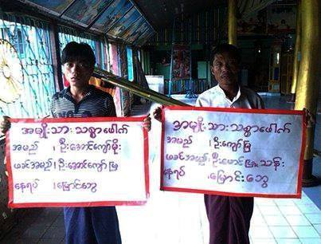
Facebook – Setting Standards, Removing Anonymity
As world’s largest social network, Facebook sees a lot of hate speech – some casual, some organized
Users asked to use real names and some prefer to delete hate speech than be exposed
Some offensive material removed if reported as violating Community Standards
Not always applied evenly
  Burmese hate speech thrives
  Legitimate groups shut down
Notes:
“Facebook also recently came up with a thoughtful and innovative solution to the problem of anonymous online hate. While Facebook’s real-name policy means that a user will be identified with his or her posts, Facebook Pages allow for anonymous postings. Some of those postings cross a line—not the Community Standards line Facebook sets, which allows the immediate deletion of the content—but a line that when crossed can lead to distress for, and potential harm to, minorities. The frequently invoked example is humor that has racist, homophobic or anti-Semitic meaning. When such content appears on Pages and is brought to Facebook’s attention, Facebook asks the Page “administrator” (a Facebook user) to have his or her real name associated with the Page. Not surprisingly, most users prefer to remove the content rather than be associated with it.” (https://www.privacyassociation.org/privacy_perspectives/post/in_curtailing_hate_speech_online_will_privacy_sometimes_have_to_take_a_back)

Slide 27


New York Times – Emphasizing Identity in Online Forums
Recognize that anonymity strongly encourages hateful and “uncivil” language online
Major problem in comments sections of articles on their website
Solution was to give priority to posts associated with real names
Anonymous or clearly fake name posts pushed to bottom

Slide 28
Lessons Learned - What Works
Persuasive approaches work best
  People will resist being told how to think
Public shaming can be effective
  Not necessarily explicit
  Simply removing anonymity can work

Slide 29
Lessons Learned - What Works
Presenting alternative views to persuade neutral
Breaking down social barriers
Educating people who know little about other groups
Encouraging them to see the “other” as an equal person
Encouraging people to become “real life” interveners

Slide 30
Lessons Learned - What Does Not Work
Censorship and simply silencing hate are ineffective on social media
When one outlet is neutralized, hate promoters find a new channel
Opens up difficult debate on freedom of speech
Too difficult to apply across multiple jurisdictions

Slide 31
Challenge: Linking Online Efforts to Real-World Change

Slide 32
Need More Than Words Alone
Changing attitudes is a long-term project
Laws and declarations are not enough
Questions are:
  How do we turn online communications into offline action?
  How can we use online communications to support legal initiatives?
Keep these questions in mind for upcoming discussion session

Slide 33
QUESTIONS?

